Slide 1

Technology News blog
HCI Final Project – 3C16
Group 01: Bùi Ngọc Trung
Bùi Quang Thành
Đỗ Mạnh Hải
Vũ Quang Anh
Nguyễn Duy Tùng

Slide 2
Table of contents
1
Introduction
Brief overview of creating this website
2
Website Features
Present the main features in our website and how they work
3
Reasons to choose
Detailed explanations about why you should use our product

Slide 3
Introduction

Slide 4
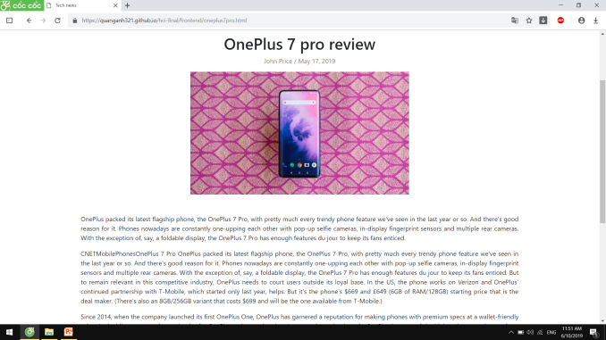
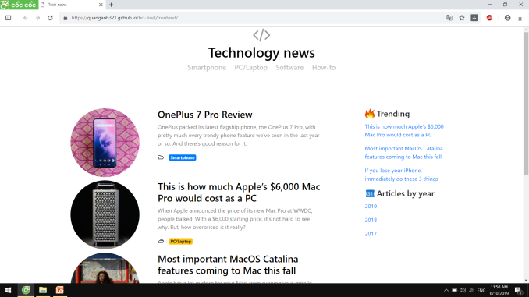
Technology News
This is a technological website which provides latest news and tricks related to IT knowledge area.

Slide 5
Website Features

Slide 6
Features
Manage files
Manage users roles
Adding, renaming, deleting files
Manage categories
Divide access authority for each type of users
Manage posts
Creating new posts, editing and deleting available categories.
Creating new posts, editing and deleting available posts based on users roles.

Slide 7
Reasons to choose

Slide 8
Reason to choose
01
User-friendly Interface
02
Trending news
Inspired by the minimalism in designing (for ex:medium.com), our website has no complicated effects and various colors pattern to bring out the simple & friendly interface for all types of people, which also apply current design trends in the world.
All the news on the websites are always up-to-date, keep pace with the information in technology world, helping people get a broaden knowledge with today flows.
03
Recommendation
04
Tips & Tricks
After you finished reading one articles, others that have the same knowledge area will also be appeared, which give you more chance to know and a more widened knowledge about this topic.
Some interesting and practical tips are also included on the website to make uses of our digital devices.

Slide 9
Thank you !

